Slide 1


Spreadsheet Project Zomato Restaurant Expansion A Data-driven Analysis & Recommendation By Mayank Sinha Date :- 31-12-2025

Slide 2
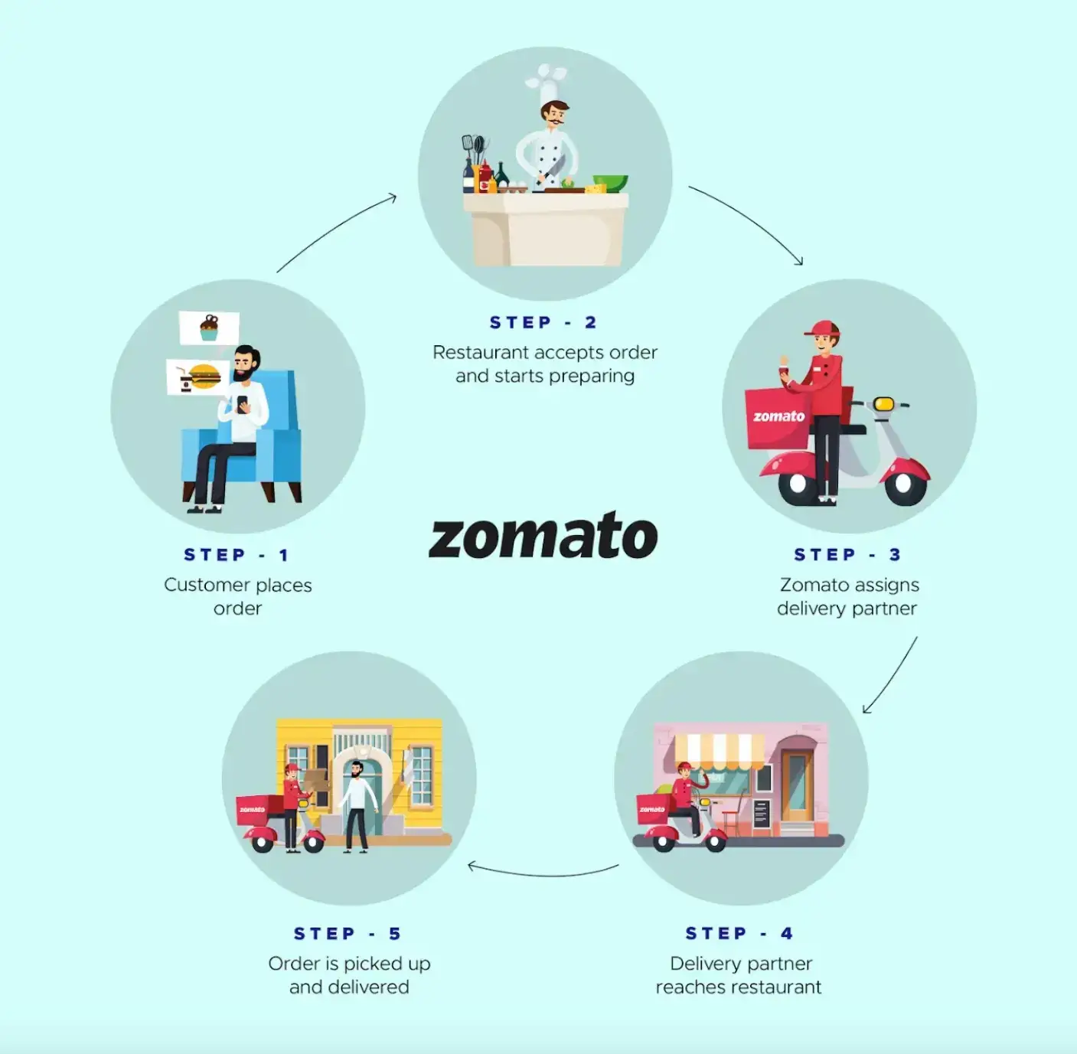
What is Zomato & how does it work?
Zomato is one of the most comprehensive and user-friendly apps for finding nearby restaurants and cafés to dine in or to order food online.
Zomato's primary function is recommending local and neighbouring eateries to users and taking orders from them.
Users can use this information to place orders and enjoy delectable food in the comfort of their own homes. Zomato offers timely delivery to customer's doorstep, a joy for foodies. Customers no longer have to wait in restaurants for hours.
Founded by Deepinder Goyal in 2008.
Zomato's working model is simple. To enjoy a lip-smacking meal, customers have to follow these five simple steps-
Step 1
Users may browse and order food from various restaurants via the desiccated app or website.
Step 2
When restaurant owners receive an order request, they prepare a dish.
Step 3
As the food is prepared for delivery, it is given to delivery companies.
Step 4
The delivery service delivers food to the customer's preferred location.
Step 5
Customers can make purchases and provide evaluations based on their experience using the payment options.

Slide 3
Agenda.
Problem Statement
Objects Of Project
Data Description & Methodology
Key Metrics & Visualisation

Slide 4

Problem Statement.
Zomato is seeking to expand its presence by identifying new strategic locations for restaurant openings. This project utilizes data-driven insights to suggest optimal areas for expansion based on ratings, price, votes and cuisines.

Slide 5
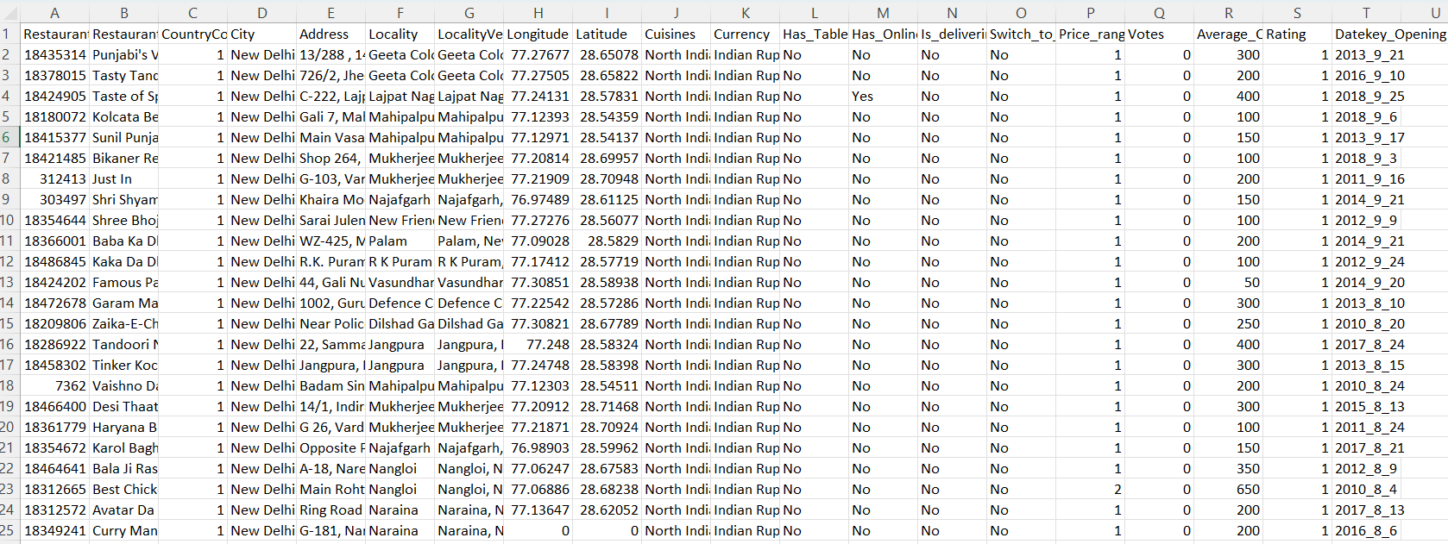
You are hired as a consultant data analyst by Zomato where the team is looking for expansion and opening more restaurants. Your task is to develop strategies/suggestions for opening newer restaurants.

Slide 6
Objective Of Project
Determine possible countries for Zomato's growth.
Analyze market patterns.
Restaurant distribution.
Customer feedback, and pricing strategies to determine potential growth opportunities for Zomato.
To enhance service delivery, collect feedback and customer satisfaction statistics.

Slide 7
Data Overview
Restaurant ID: Unique identifier for each restaurant.
Restaurant Name: The name of the restaurant.
CountryCode: Country code of the location where the restaurant is situated.
City: The city where the restaurant is located.
Address: The specific address of the restaurant.
Locality: The locality or neighborhood where the restaurant is situated.
Locality Verbose: Detailed information about the locality.
Longitude: The geographical longitude coordinate of the restaurant.
Latitude: The geographical latitude coordinate of the restaurant.
Cuisines: The type of cuisine offered by the restaurant.
Currency: The currency used for transactions in the restaurant.
Datekey_opening: The date when the restaurant was opened.
Has_Table_booking: Indicates whether the restaurant has a table booking option (Yes/No).
Has_Online_delivery: Indicates whether the restaurant offers online delivery (Yes/No).
Is_delivering_now: Indicates whether the restaurant is currently delivering (Yes/No).
Switch_to_order_menu: Indicates whether users can switch to the order menu (Yes/No).
Price_range: A numeric value indicating the price range category of the restaurant.
Votes: The number of votes or ratings/(feedback) received by the restaurant.
Average_Cost_for_two: The average cost for two people dining at the restaurant.
Rating: The overall rating of the restaurant is based on user reviews.

Slide 8
Data Snapshot
Total Restaurants | 9551
Total Countries | 16
Total Cities | 140
Total cuisines | 1821
Service offered | Online Booking, Table Booking
Average Rating | 2.89
Average price in INR | ₹863

Slide 9
Methodology
Data Cleaning:
Addressed missing entries in the Cuisine column.
Eliminated unnecessary columns.
Data Enrichment:
Enhanced the dataset by incorporating country information through VLOOKUP based on the country code.
Derived year from the date key opening using text functions to facilitate analysis of temporal trends.
Descriptive Analysis:
Used pivot tables and pivot charts for dynamic summarization and visualization, enabling clear and actionable insights.

Slide 10
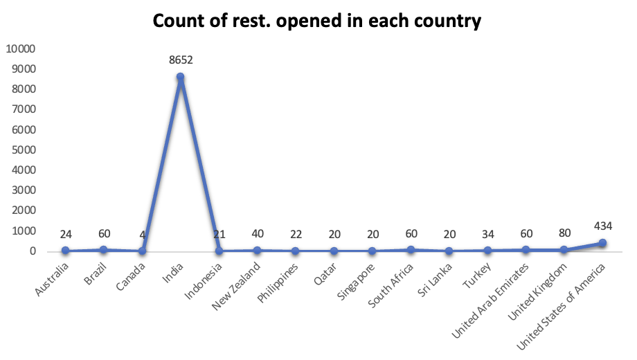
Key Metrics and Visualization
Count of Restaurants:
Calculated the total number of restaurants per country and visualized the insights through charts.
It is advisable to open new restaurants in Brazil, Sri Lanka, Canada, and Australia.

Slide 11
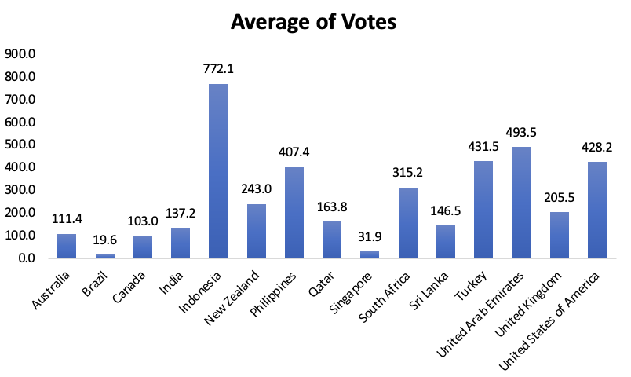
Calculated the average number of voters per restaurant by country for comparative analysis. A country with significant proportion of voters indicates more interaction with customers.
Example from Chart: Indonesia, UAE, Turkey.
Average number of Voters in each country:

Slide 12
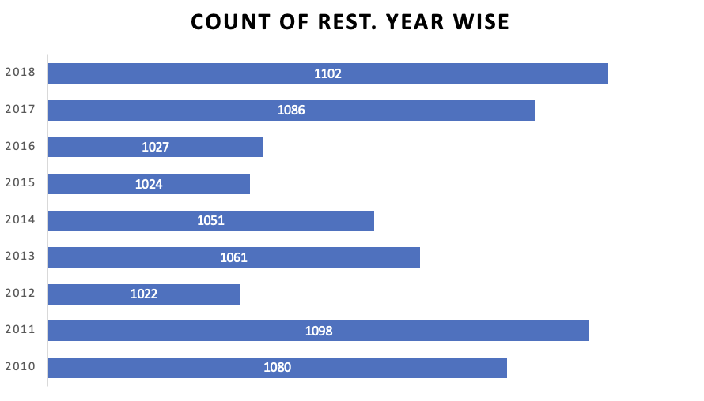
Restaurants opened each year:
A higher number of restaurants suggests greater consumer involvement. Example from Chart: Years 2011, 2017, and 2018

Slide 13
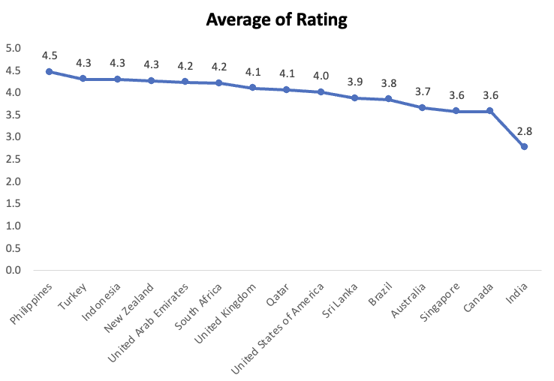
Average Rating of Restaurants in each Country:
It is mandatory to understand ratings of restaurants in order to develop marketing plans and assess performance.
High rating: Philippines, Turkey [These countries face major market demands].
Low rating: Canada, Singapore [Improvements must be made]

Slide 14
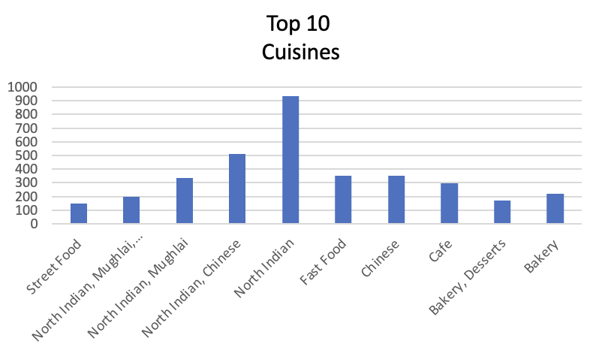
Top 10 Cuisines:
North Indian and Chinese are most popular cuisines.

Slide 15
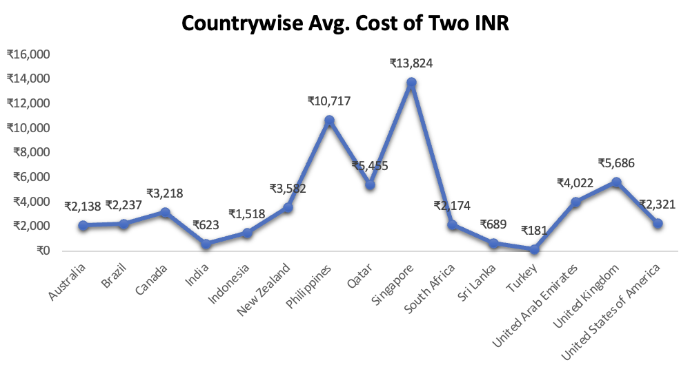
Average cost of two INR:
Singapore is the most expensive, averaging .
India and the UAE offer the most affordable dining.
Only Singapore and the Philippines (over ) exceed this threshold.
The UK is over double the cost of the USA, showing major differences even within key markets.

Slide 16
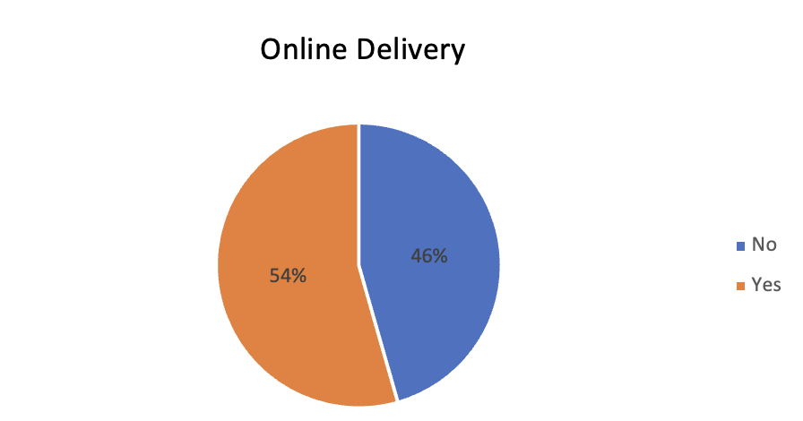
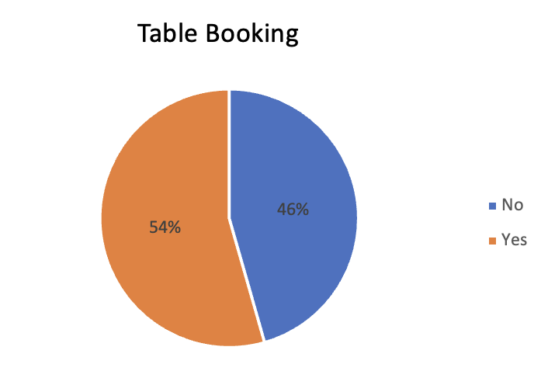
Delivery and Table Booking Analysis:
Restaurants with online delivery and table booking have slightly better average ratings.
Having an online presence caters to more people and increases the overall rating.
New restaurants should offer at least table booking or online delivery—ideally both—to improve ratings.

Slide 17
Recommendations:
Focus on opening new restaurants in countries with strong potential and healthy competition.
Prioritise markets with fewer existing eateries for easier entry.
Use restaurant density analysis to spot growth opportunities and prime customer locations.
Identify major competitors to inform strategies for differentiating new venues.
Understand customer sentiment to guide improvements.
Provide quality food and smart pricing to attract and retain customers.
Implement online delivery and booking systems to boost satisfaction and ratings.

Slide 18
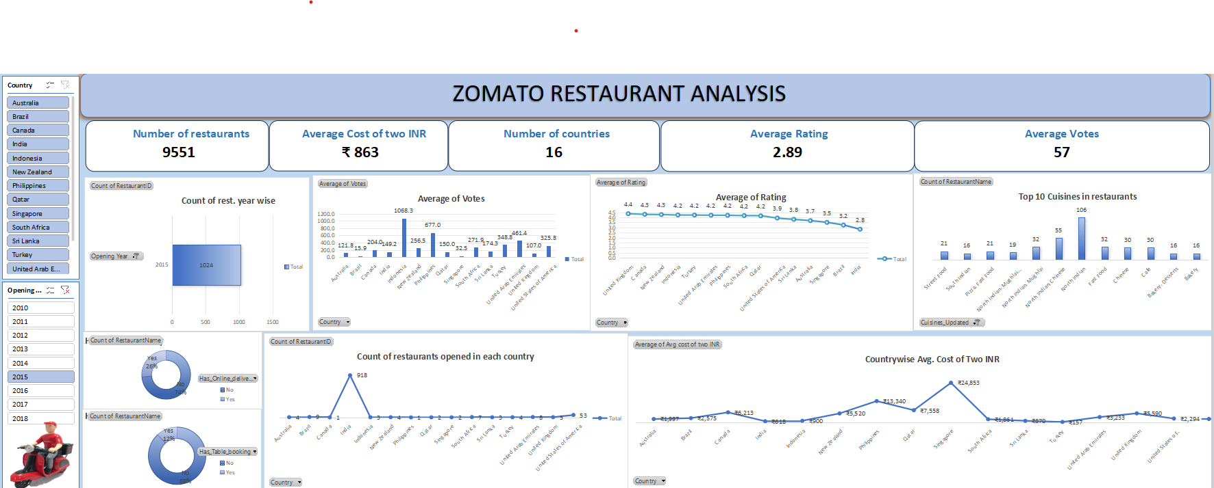
Final Dashboard:

Slide 19
Conclusion:
An in-depth examination of restaurant data has shown a number of promising prospects for international growth.
We can strategically place ourselves in markets with less competition by concentrating on nations with high average ratings and smaller restaurant densities.
North Indian, Chinese, Fast Food, Café, Bakery, Desserts, Street Food are the top cuisines available in restaurants across all countries.
Given their high levels of consumer satisfaction, targeting cities in the Sri Lanka and Indonesia has great promise.

Slide 20
THANK YOU

